Slide 1


DIE FALLE DES FALSCHEN SICHERHEITSGEFÜHLS
DIE FALLE DES FALSCHEN SICHERHEITSGEFÜHLS
WIE SICH ENTWICKLER SICHER SICHER FÜHLEN
Notes:
Wer kennt das Gefühl von: “Läuft mein Code, oder was kann alles schiefgehen?”
bzw. zwecks Schlafen in der Nacht

Slide 2

Wenn du so vehement die Ursachenforschung unterbindest, musst du dich nicht wundern, dass sich das Problem nicht lösen lässt.
Wenn du so vehement die Ursachenforschung unterbindest, musst du dich nicht wundern, dass sich das Problem nicht lösen lässt.
– Marc-Uwe Kling // Die Känguru-Apokryphen
Notes:
Erfahrungsbericht
da Pharma-Branche und Quality-Startup versuchen wir einfach viele Prozesse zu hinterfragen (dev, mgmt)
nicht der Weisheit letzter Schluss, aber halt wie es uns ergangen ist

Slide 3

ASSURING QUALITY BY
PSYCHOLOGY

Slide 4
Problemstellung
Produktarchitektur
Training Management System
Trainings in VR
psychologischer Aspekt
Unity
Gaming
Teamaufbau
Entwickler
VR
Web
Psychologen
Content-Producer
aber sehr kleines/heterogenes Team mit vielen Schnittpunkten
Notes:
worum gehts denn bei uns eigentlich genau
was sind die Schwierigkeiten (technisch, personell, psychologisch, …)

Slide 5

Mindset/Team-Building/Wissensaustausch
Workation
Meetings
P49: chatting @ work
heterogenes Team
nicht wirklich austauschbar

Slide 6
Kommunikation
Kommunikation
Outlook
Slack
Jira
Confluence
WhatsApp

Slide 7
Projektplanung/Zeit schätzen
Startup Initialphase
Frameworkentwicklung vs. Produktentwicklung (Zeitfaktor, aber solide Basis)
VR Entwicklung Interaktionsmuster vs. Agentur App-Entwicklung (95% easy abschätzbar)

Slide 8
Entwicklungsprozess (Lean SCRUM)
P72: egoless programming
https://en.wikipedia.org/wiki/Egoless_programming
https://blog.codinghorror.com/the-ten-commandments-of-egoless-programming/
Jira
Jenkings
GitHub + Pull Requests
P16: “Because people do not read programs, few are aware of how common this situation [actually useful code] is.

Slide 9
ASSURING QUALITY BY
TECHNOLOGY

Slide 10
anecdote correctness (p17)
👨‍🎤 ✈ 🏭 💾 🚗 💺 📚 👥 🙅‍♀️ 💥 🌙 👥 👨‍🎤 🔚 ✈ 😌 🚀 👷‍♂️ ❌ 🙅‍♀️ 👨‍🎤 ⌚ 👨‍🎤 👨‍💼 😎 ✈ 🏭 🤝
“Of all the requirements that we might place on a program, first and foremost is that it be correct.”
Example
Dialogue (oc: original creator, h: hero, t: team)
oc: “And how long does your program take?”
h: “That varies with the input, but on the average, about ten seconds per card.”
oc: “Aha, but my program takes only one second per card.”
t: relieved
h: “But your program doesn’t work. If the program doesn’t have to work, I can write one that takes one millisecond per card-and that’s faster than our card reader.”
Notes:
let’s start with a small story
hero programmer called to Detroit to debug a program
the program had to determine parts to build certain sets of automobiles
upholstery based on the body color, body style, deluxe and air condition (complexity because of extra space)
original solution, 1 branch per decision path, resulting in 5000 branches, done by 16 developers, impossible to test and debug
original state: 8 tires, no engine, three sets of upholstery
original fix: night shifts and more programmers
hero decided to give up and fly home: on the plane he had time to reflect calmly
rewrote to an engineering specification parser (now engineers did the specification part)
in the meantime project was cancelled as impossible to write
here dev time
program on the plane, 1 day finishing, 2 days specification, 7 days testing

Slide 11
👨‍🏭
And how long does your program take?
👨‍🎤
✈
🏭
💾
🚗
💺
👨‍🎤
That varies with the input, but on the average, about ten seconds per card.
📚
👥
🙅‍♀️
💥
🌙
👥
body color
body style
equipment
air condition
👨‍🏭
½ day on the plane
1 day finishing
2 days for specification
7 days testing
Aha, but my program takes only one second per card.
👨‍🎤
🔚
✈
😌
🚀
👷‍♂️
❌
🙅‍♀️
👨‍🎤
⌚
👨‍🎤
👨‍💼
TEAM FEELS RELIEVED
👨‍🎤
But your program doesn’t work. If the program doesn’t have to work, I can write one that takes one millisecond per card-and that’s faster than our card reader.
📈
✈
🏭
🤝
🚅
✔
about correctness in computer systems

Slide 12

WE HAVE LIMITED SPACE FOR OUR WORKING MEMORY, AND USING IT UP FOR ANYTHING A COMPUTER CAN DO FOR US IS COUNTER-PRODUCTIVE.
WE HAVE LIMITED SPACE FOR OUR WORKING MEMORY, AND USING IT UP FOR ANYTHING A COMPUTER CAN DO FOR US IS COUNTER-PRODUCTIVE.
– Chris Allen

Slide 13
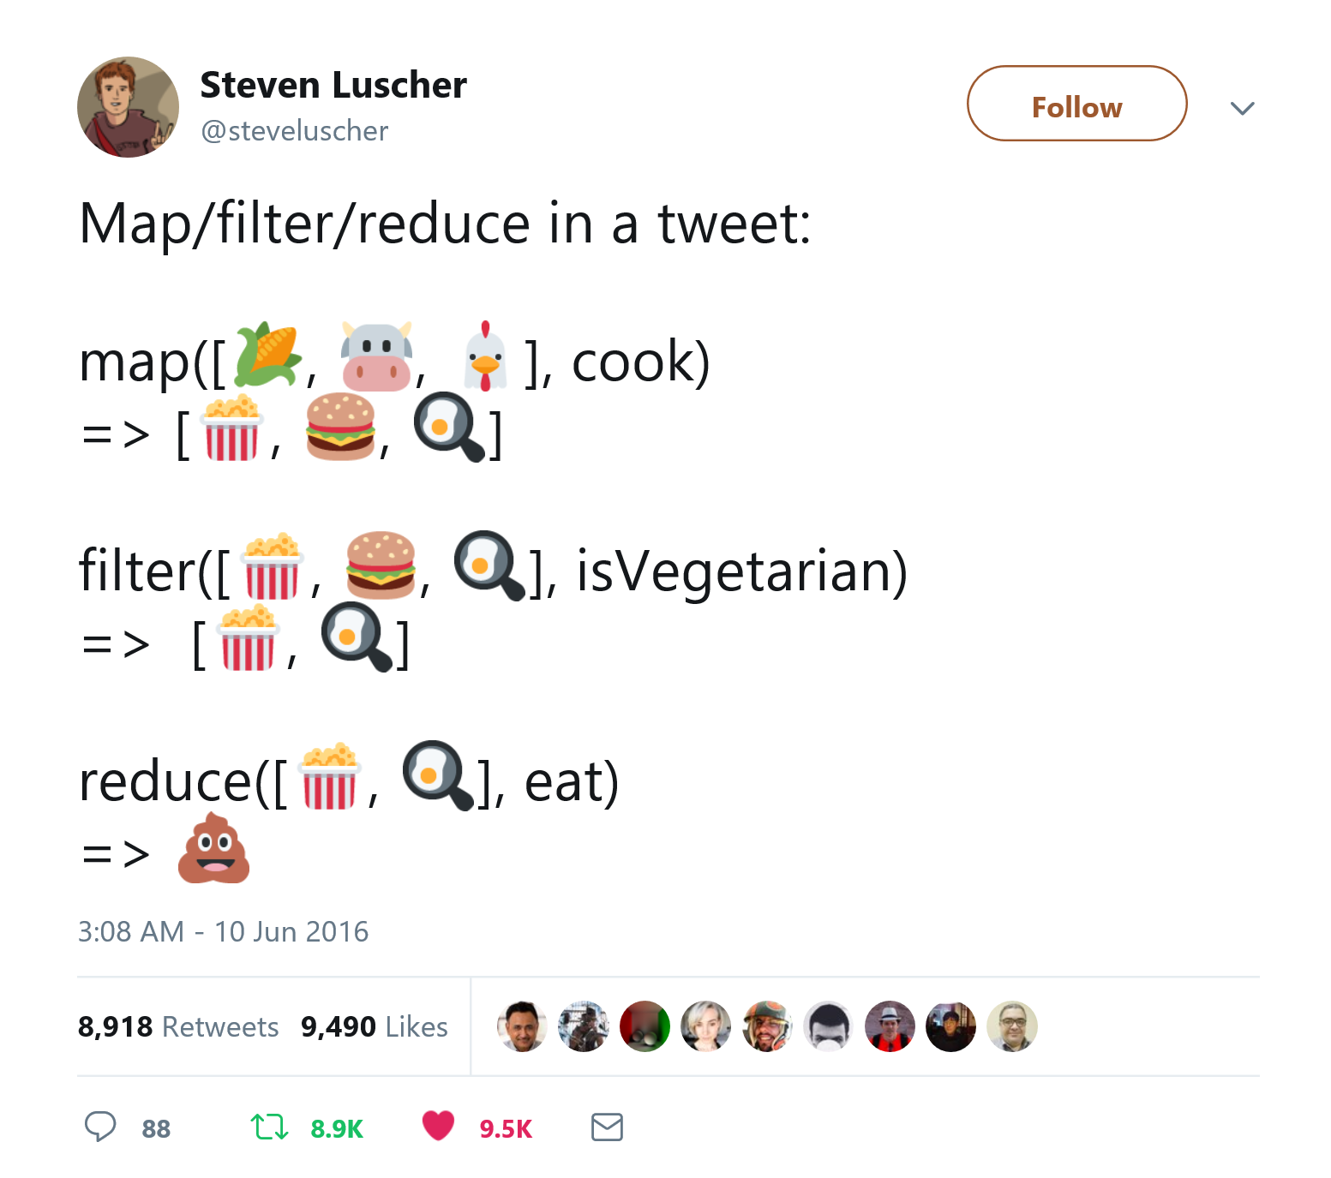
Safety by using Expressions
instead of statements
“what not how“
no side-effects (mutations)
there has to be an initial value
else-branch is required
composable
example { ditch the if }
example { ditch the while/do/for }
[1], [2]

Slide 14
Safety by using Types
instead of living in anarchy
null vs. nlkl/Optional
mcintyre321/ValueOf (Domain Modelling)
Union Types/Sum Types (mcintyre321/OneOf)
Slaying a UI Antipattern with ELM
but use it in vue with express failing backend, + 3 increments
isLoading + hasError + null
isLoading + errorMessage
‘not-loaded’ | ‘loading’ | ‘success’ | ‘error’
Why Exceptions are not the answer to everything, vs. Errors
10 Reasons not to use a statically typed functional language: https://fsharpforfunandprofit.com/posts/ten-reasons-not-to-use-a-functional-programming-language/
P10: “Still, we may not feel these limitations until they have been lifted from us, just as we often do not know we are sick until we suddenly feel better.”
example { nlkl/Optional }
example { mcintyre321/ValueOf }
example { mcintyre321/OneOf }
example { Slaying a UI Antipattern }
[1], [2], [3], [4], [5]

Slide 15
Safety by generating Code
instead of writing it manually
example { NSwag }
example { VS-Typewriter for SignalR }
[1], [2]

Slide 16
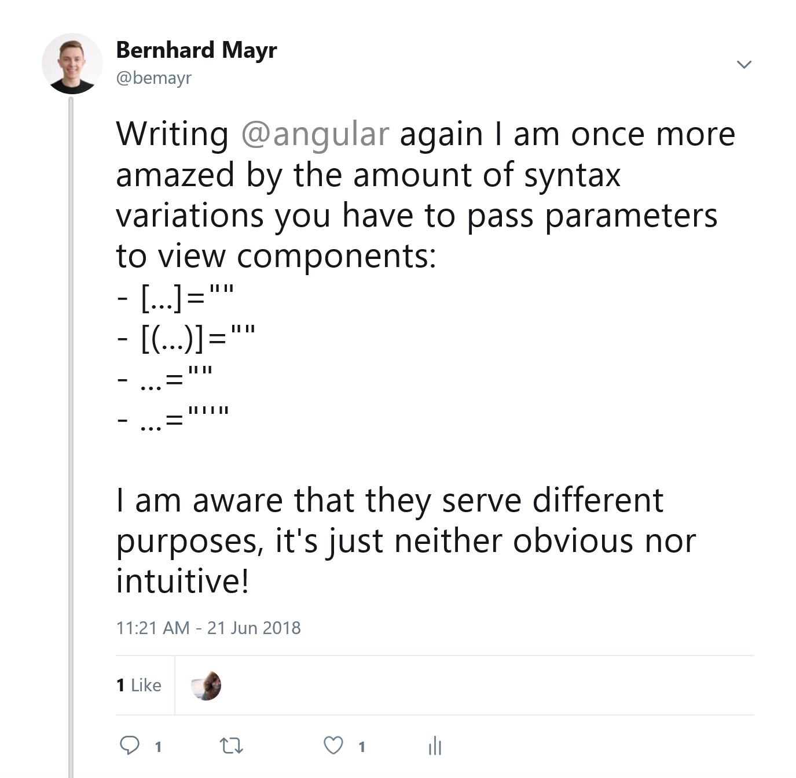
Safety by creating DSLs
instead of template languages
example { C# Fluent Time }
example { Verbal Expressions }
example { type-safe HTML & CSS }
TODO
C# Time
https://stackoverflow.com/questions/17224090/how-can-i-write-a-fluent-datetime-value#comment24953860_17224151
https://github.com/softawaregmbh/library-holidays/blob/experiments/softaware.Holidays.Core.Tests/Tests.cs
Regex (Verbal Expressions)
http://verbalexpressions.github.io/
Templates vs. In-Language DSLs
HTML
Angular Template Language: https://twitter.com/bemayr/status/1009743078532501504
https://groups.google.com/forum/#!msg/elm-discuss/uXjcVyZ5IYo/g2FlQYc9RjYJ
https://github.com/elm/html
CSS
https://github.com/rtfeldman/elm-css
https://github.com/mdgriffith/elm-ui
https://typestyle.github.io/#/

Slide 17
Safety by using Dev-Tools
instead of using eclipse
consistency
less work (semicolons)
bugs
ben lesh
git-diffs
example { tslint/dotnet analyzers }
example { prettier }
[1], [2]
Notes:
[Fact]
public void TestUnixInitialDate()
{
Assert.Equal(new DateTime(1970, 1, 1), this.dateGenerator.UnixInitial());
}
linting: tslint/dotnet Analyzers/StyleCop
formatting: prettier, go-fmt, elm-fmt

Slide 18

Future<?>

Slide 19
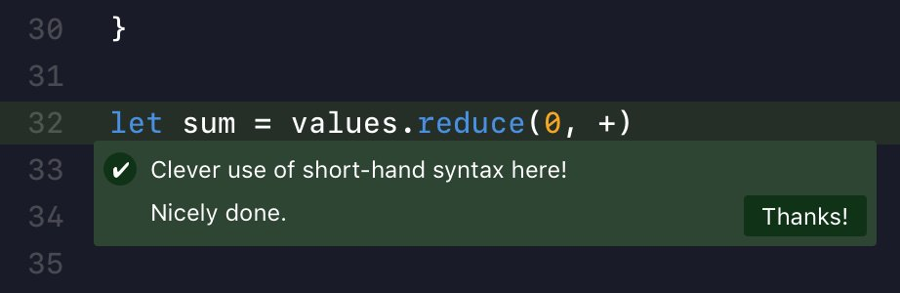
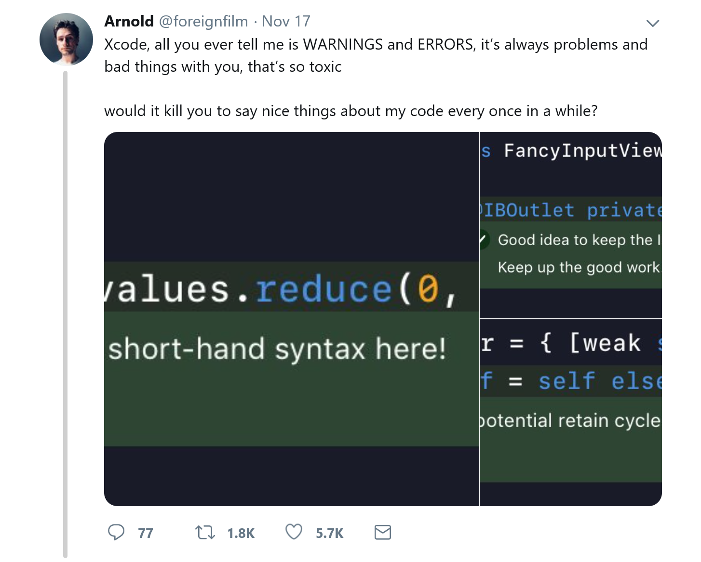
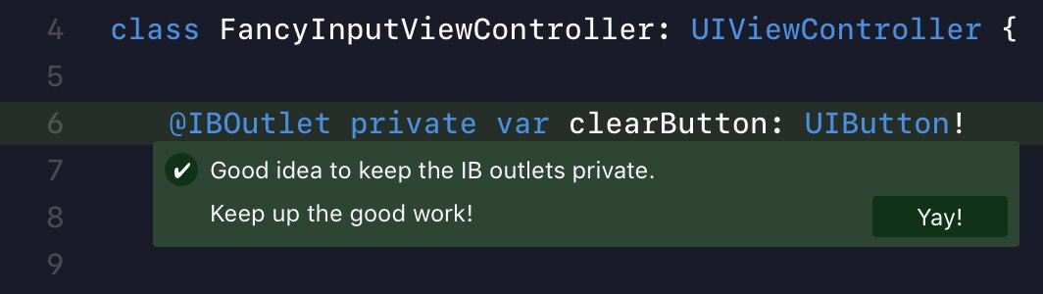
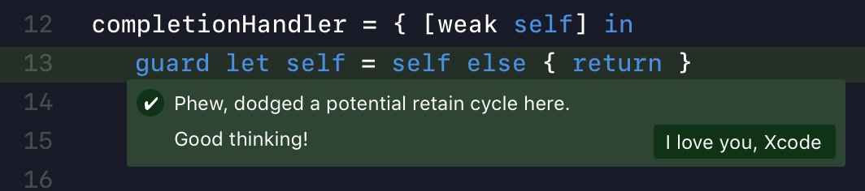

/FOREIGNFILM

Slide 20

THE COMPILER AS YOUR ASSISTANT THE IDRIS LANGUAGE
Edwin Brady
This doesn't free you from knowing what you are doing, but it does save you from doing the step that really the machine should be able to get by itself.
I like to think of the machine not as a thing that checks my code, but like my lab assistant. [...] We are gonna do some pair-programming, me and the machine.
example { type-driven development }

Slide 21
RECAP
RECAP
Being intelligent is not having some magic formula which can one apply to every problem. It is, rather, having a number of ‘formulas’ and not being so much in love with one that it cannot be dropped for another.
– GERALD M. WEINBERG

Slide 22





studying psychology and philosophy @ university of innsbruck
studied software engineering @ fh hagenberg
working as a software architect @ innerspace gmbh
Bernhard Mayr
/
bemayr
bemayr/talk.developer-confidence
Notes:
[30 sec]

Slide 23
Tweets
Haskell Hoogle: https://twitter.com/cemerick/status/1068359100931690496
Side Effects in Languages: https://twitter.com/widdnz/status/1067184190150430725
Sum-Types loading = false: https://twitter.com/DavidKPiano/status/1063501519339835397
C# vs. F#: https://twitter.com/MikhailShilkov/status/1011705530648334337
pure vs. impure: https://twitter.com/jckarter/status/1009585088953081856
performance vs. readability: https://twitter.com/DavidKPiano/status/1005107850849456128
Justin’s String Type: https://twitter.com/jusrin00/status/875238742621028355
C# Union Types: https://twitter.com/bemayr/status/993845739657850880
Types Documentation: https://twitter.com/iamsapegin/status/989030140280745985
Compiler vs. Brain: https://twitter.com/bemayr/status/988866064988737539
Types and Compiling: https://twitter.com/ezyang/status/986079031484407808
jsdoc types: https://twitter.com/jusrin00/status/971369672393281536
Refactoring Haskell: https://twitter.com/TheWizardTower/status/963193617287233537
FP Love: https://twitter.com/jdegoes/status/932999912488235010
Hardware vs. Software: https://twitter.com/CodeWisdom/status/908752665408081920
Types vs. Unit Tests: https://twitter.com/peterpme/status/892593371188998144
Staltz Bug Report vs. Compile Error: https://twitter.com/ARealMaxPixel/status/864891754373234688

